Slide 1
WhatsApp Events
Ram Vinjamuri

Slide 2
Motivation to build
Repetitive reminders are routine operations
Desire to streamline and enhance this process
Automate messages while increasing engagement
Need for creativity

Slide 3
What I built
-Robust backend powered by Python
- Hosted as a Linux bot
- User-friendly frontend developed using Flask.
The backend interacts with
GreenAPI through HTTP requests
GPT 3.5 Turbo

Slide 4
What LLMs were used
Optimal Reminder Times:
GPT predicts the ideal times for sending reminders
Eliminating the need for manual selection
Engaging WhatsApp Prompts:
The language model generates captivating WhatsApp messages.
User Input Sanitization:
GPT assists in sanitizing user inputs
Predicting values from other cases to enhance user experience.

Slide 5
Conclusion + Impact
Testaments to the power of AI in simplifying and enhancing communication.
By automating routine reminders with GPT 3.5 Turbo, the project not only saves time but elevates the engagement level through creatively crafted messages.
In conclusion, "WhatsApp Events" is a testament to the power of AI in simplifying and enhancing communication.
By automating routine reminders with GPT 3.5 Turbo The impact extends beyond mere convenience, introducing a novel approach to personalized event notifications.

Slide 6
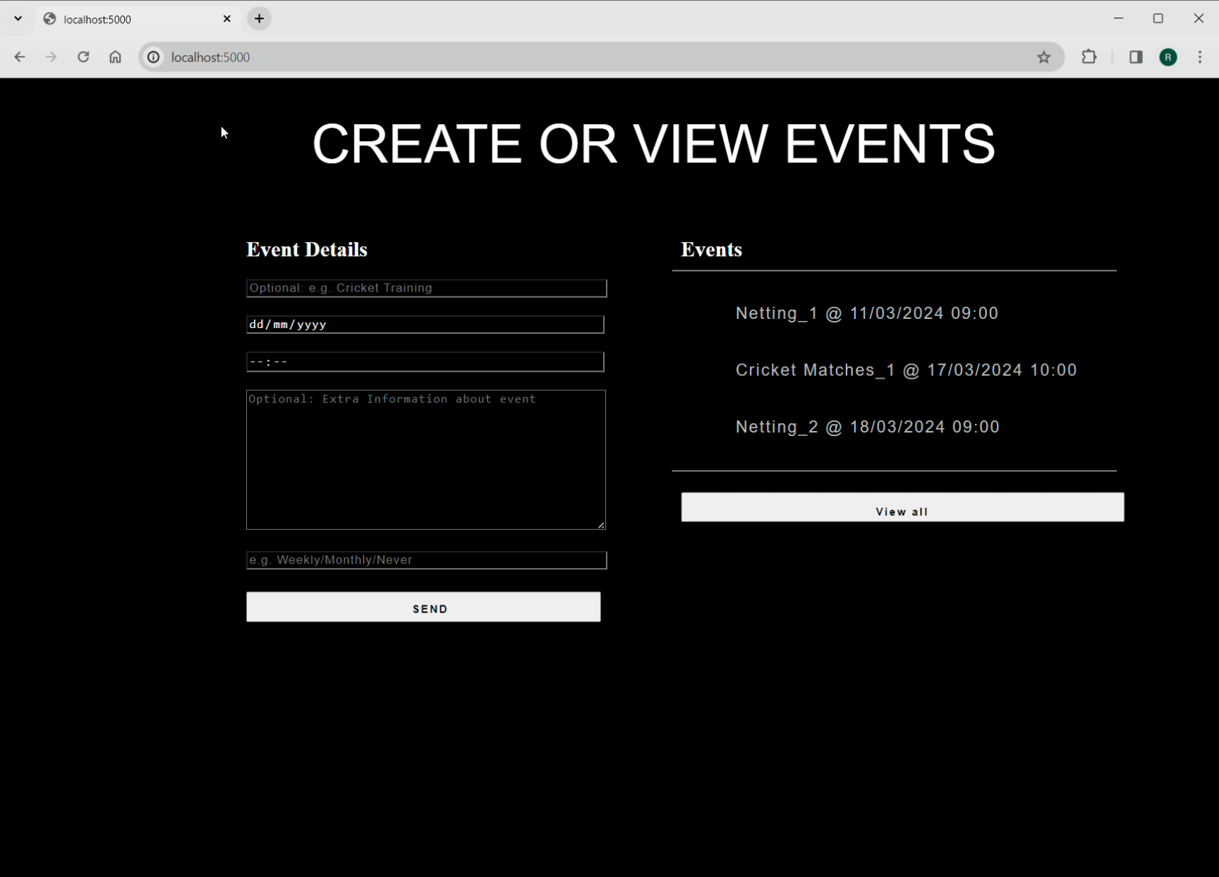

Slide 7
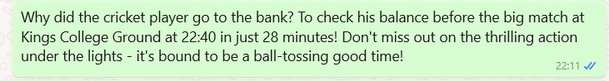
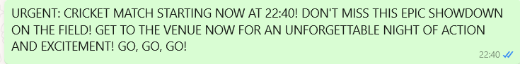
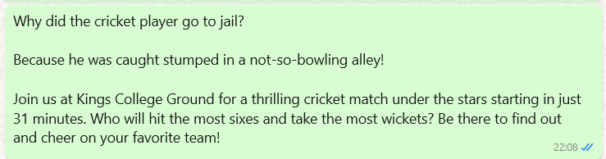

Examples
Reminders
Event Occurrence
Note: Not restricted to cricket

